Slide 1
AR for Learning and Accessibility: Insights from a Systematic Review of the Literature and an Environmental Scan (with an Early AR Accessibility Checklist)
Shalin Hai-Jew, Kansas State University

Slide 5
Presentation Overview
Recently, the presenter conducted a systematic review of the academic literature and an environmental scan to learn how to set up an augmented reality (AR) shop at an institution of higher education. The ambition was to not only set up AR in an accessible and legal way but also be able to test for potential +/- effects of AR on teaching and learning. The research did not go past the review stage, because of a lack of funding, but some insights about accessibility in AR were acquired.

Slide 6
Presentation Overview (cont.)
AR is seen by some researchers as supportive of learners with alternate (alt) needs in various ways because it provides another modality, another channel, for perception and cognition. Others find challenges in too much motion and busyness and shapes/colors. There are challenges in offering information in multiple channels, and others.

Slide 7
Presentation Overview (cont.)
There are inherent challenges with the following elements and more:
visual presentation and communications: low resolution in outdoors AR, insufficient color values and contrasts, the use of color as a single channel to convey information;
insufficient information: poor object labeling, an absence of text transcripting for sound and video;
physical challenges: maneuverability challenges in some built AR spaces, unwieldy wearables and tangibles;

Slide 8
Presentation Overview (cont.)
unclear navigability: unclear (or absent) user interfaces;
triggering effects: the presence of strobe effects, uncontrollable motions, speedy motions, a lack of user controls, a lack of clear user controls;
cybersickness: feelings of nausea and dizziness from some AR experiences (given the paucity of visual information as compared to a real-world visual field, given flicker and timings);
and others.

Slide 9
Presentation Overview (cont.)
This work provides an overview of the AR findings and an early list of insights for AR accessibility and ideas for potential mitigations.

Slide 10
Notes:
These are still images, but they imply 3d and 4d (the third dimension and the fourth dimension / motion).

Slide 12
What is Augmented Reality?

Slide 13
First Use of the Term
Thomas Caudell (of The Boeing Company): “Augmented reality” was first used in 1990 given its usage in industrial manufacturing
AR superimposed information “on the visual field to make it easier for workers to lay aircraft cables” (Caudell & Mizell, 1922, as cited in Doerner, Broll, Jung, Grimm, Göbel, & Kruse, 2022, p. 25)

Slide 14
Definition
R. T. Azuma (1997) first defined AR as a system that “combines real and virtual,” is “interactive in real time,” and is 3d (p. 356).
“AR” does not restrict the technologies used, as various forms may be used.
These include projection, lighting, head-mounted displays, mobile apps (tablet devices, smartphones), and many others.
The various devices have strengths and weaknesses.

Slide 15
Marker-Based AR / Markerless AR
Marker-based AR requires the use of a camera to acquire particular visual codes (or “image anchors”) to trigger the AR to display / play / spawn. [QR codes are a common example.]
Markerless AR spawns without visual triggers but perhaps with users being detected in a locality (through proximity triggers).
Other conditionals may be set up to act as triggers.

Slide 16
Augmented Reality for Teaching and Learning

Slide 17
Practical Documented Uses of AR
Exploratory art spaces
Museums
Virtual laboratories
Interactive gaming
Simulations
Design labs, design studios
Learning modules
Campus tours
Electronic publications (e-books, e-journals, and others)
Imaginary immersive worlds
Trainings
Practices
Sales displays
And many others…

Slide 18
About AR for Learning
AR enables experiential learning that combines the real and the virtual. This is considered immersive “embodied” (vs. disembodied) learning.
The experience is visual, including 2d, 3d, and 4d (motion).
Objects may be textually / symbolically labeled.
Sound (background or ambient sound, event-based sound) may be included.
The experience may be interactive (human with physical tactual objects / tangibles, human with digital objects, and other combinations) (including with “collision detection” for virtual AR elements).
The experience may be social and collaborative (with people physically present or visually tele-present).

Slide 19
About AR for Learning (cont.)
The AR experiences may be indoors- or outdoors- or a mix of indoors-outdoors.
One term used for AR spaces is “spatial augmented environment” (Oswald, Tost, & Wettach, Nov. 2014, p. 1).
The external AR experiences may be in the daytime or at night…
More sophisticated systems enable adaptive contrast and lighting given conditions.

Slide 20
About AR for Learning (cont.)
The AR experiences may be location-based (locative), in a geographical sense.
Some are world-scale experiences.
AR may be part of a walk-sequence, for example.
The AR experiences may be non-location-based. It can be delivered on an app and mobile device anywhere in the world. Some require use of headsets, wearables, and others. Some use projectors. They may be spawned anytime-anywhere, in a ubiquitous way.
AR experiences may be delivered remotely (virtually) for online learning.

Slide 21
About AR for Learning (cont.)
The designed AR can be exploratory.
Or it can be guided (such as having individuals or small groups move from station to station).
AR may be experienced individually or in small groups.
The AR experience may be dynamic.
For example, data may be streamed to change the scene or parameters of the scene.

Slide 23
Data Collection
Some AR systems enable instructor controls to understand a physical space in which multiple learners are interacting.
In some cases, instructors have admin-level access to systems to change up the AR for the learning.
Some AR systems enable data collection from the teaching and learning.

Slide 24
Scale and AR
Some AR systems are desktop ones, such as for e-publications.
Others are mass-scale, such as projected displays painted on the sides of skyscrapers.
And others are larger still, with global scale ARs designed around particular themes and / or knowledge.
These depend on GPS coordinates.

Slide 25
Some Learning Concepts
Applied to AR

Slide 26
Learning Concepts re: AR
Formal, nonformal, and informal learning:
AR applies to pre-school to post-graduate school learning in formal (accredited) learning.
It has been used in non-formal learning (non-credit designed learning, trainings).
It has been used in informal learning (incidental learning from lived experiences).

Slide 27
Learning Theories Applied to AR
Bloom’s (1956, 2001) taxonomy of learning objectives
Create
Evaluate
Analyze
Apply
Understand
Remember

Slide 28
Learning Theories Applied to AR (cont.)
Piaget’s (1964) constructivism (learners are not passive receptacles of information but actively sense-make; learning has to be active; learners have to be active agents in their learning and make relevant decisions and choices)

Slide 29
Learning Theories Applied to AR (cont.)
Vygotsky’s (1968) and Bandura’s (1977, 1986) social constructivism (meaning is made socially and in groups)
Sensemaking as individuals and as groups; individual sensibility informed by the social even if it may seem like the individual is thinking alone

Slide 30
Learning Theories Applied to AR (cont.)
Kolb’s (1974) experiential learning cycle (concrete learning, reflective observation, abstract conceptualization, and active experimentation…in a continuous cycle)

Slide 31
Learning Theories Applied to AR (cont.)
Hutchin’s (1990s) distributed cognition (knowledge and memory external to the learner, so more cognitive load may be applied to the learning at hand)

Slide 32
Learning Theories Applied to AR (cont.)
Mayer & Moreno’s (2003) multimedia learning theory (cognitive load—extraneous—in particular should be lessened given the need to process high-dimensional information in multimedia learning, with high intrinsic cognitive load and germane cognitive load, which tax the working memory)
And others…

Slide 33
How AR is Generally Designed

Slide 34
General AR Design
Goal setting
Sketching and storyboarding
Prototyping
Asset creation
AR scene layout
Interaction and animation
Testing
Sharing / publishing out (per Heather Dunaway Smith, June 20, 2022)

Slide 35
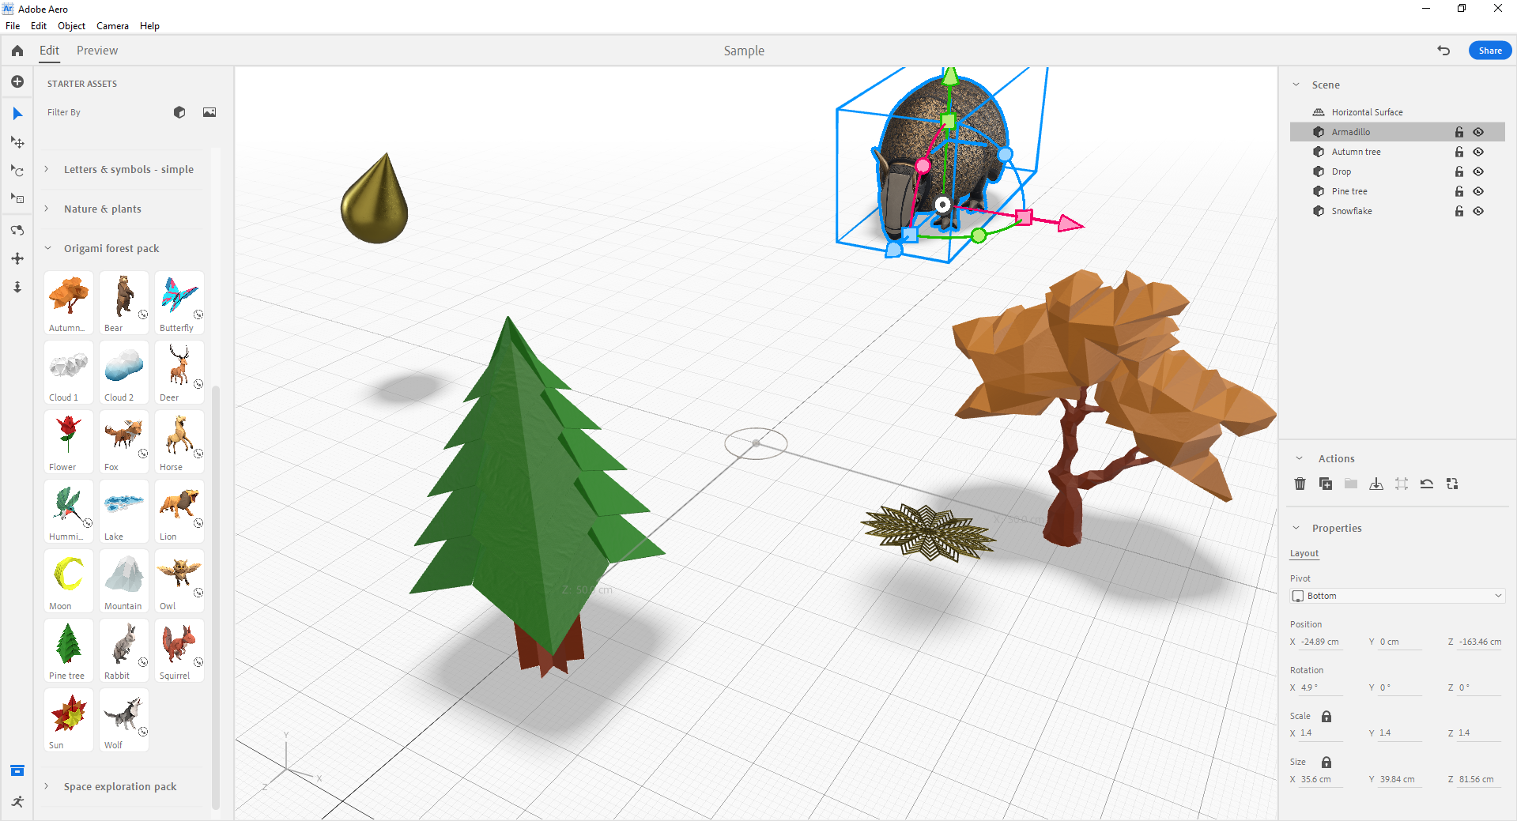

Slide 36
Context is Important
AR experiences have to draw from both the physical real world and the digital one.
For location-based AR spawns, there have to be some site-specific elements for the visuals, sound, and motion.
The digital elements of an AR display or experience tend to be in the foreground, and the physical space tends to be in the background.

Slide 37
Human Attention Has to be Guided
Human attention may be guided in various ways in an AR context:
Scale (something larger is more attention-getting than something smaller)
Color (bright colors attract more than less bright ones; warm colors are more welcoming than cooler ones, such as yellow over blue)
Positive vs. negative space (eyes go to the positive space, filled space vs. negative space)
Motion (human eyes follow motion / movement)
Audio (sound can be used to direct attention, such as helping people focus on direction…or the source of a sound…)

Slide 38
Human Attention Has to be Guided (cont.)
The visual hierarchies have to be designed to point attention to particular areas of visual interest.
There should not be competition among the visual elements, but they should be designed to serve the purpose of the AR experience.

Slide 39
Lightweight Files Needed
Human attention towards transient multimedia is limited.
Screen real estate is small (small screens), so the AR has to work within those constraints (and others).
Files in AR have to be optimized in terms of low file size, low frame rates, small sound files, and others (the bare minimum to convey the information).

Slide 40
AR as an Active Medium
AR is not made for passive consumption in many cases. It should enable interactivity…sociality…and other aspects.

Slide 41
Striving for Accessible AR

Slide 42
Visual Presentation and Communications
Adjustments for low resolution in outdoors AR
Sufficient color values and contrasts for wide range of viewability
Replacing the use of color as a single channel to convey information by offering multi-channel information
Eliminating object occlusion
Enabling scene orientation (such as seeing a part or a whole scene at the beginning…such as controlling for exits from an AR experience)
Mitigating poor viewing from various angles

Slide 43
Visual Presentation and Communications (cont.)
Sufficient time to perceive and consider the visuals, the motions, the sounds, the changes over time, and other aspects of the AR
Human minds are challenged in terms of transient details
Using familiar layouts and positions to lighten cognitive load of participants (understand visual conventions on 2d and 3d and 4d)

Slide 44
Information Sufficiency
Ensuring consistency, comprehensiveness, visibility, and other factors in object labeling
The use of basic and accurate language
Providing (enriched) text transcripting for sound and video

Slide 45
Physical Challenges
Addressing maneuverability challenges in some built AR spaces (should be wheelchair-accessible)
Ensuring safe physical spaces for the AR
Not covering learner vision
Not setting up an experience that requires walking backwards or sideways
Not fatiguing those going through the AR experience
Providing just-in-time directions, not all-at-once directions at the beginning
Mitigating unwieldy headsets, wearables, and tangibles (lightening loads)

Slide 46
Interfaces and Directions for Navigation
Addressing unclear (or absent) user interfaces
Orientation on entry, orientation on exit (individuals and groups)
Ability to re-experience sections or the whole
Clear directions for sequences, processes, and movements
Ability to exit at any time

Slide 47
Avoiding Sensory and Cognitive Triggers
Removing strobe effects (to avoid causing seizures, nausea, discomfort)
Disabling uncontrollable motions in the AR display
Removing excessively speedy motions
Avoiding a lack of user controls
Avoiding a lack of clear user controls
Eliminating excessive busyness, color, and action (causing challenges for the cognitive neurodivergent)
Omitting extraneous information that may lead to extraneous cognitive load

Slide 48
Avoiding Sensory and Cognitive Triggers (cont.)
Considering how sensitive and controversial topics may be addressed
Avoiding communicating exclusionary or discriminatory messaging in the AR visual
Being aware of how visual, audio, motion, interaction, and multimedia may be misinterpreted (as humans tend to read into their experiences per apophenia and other aspects)

Slide 49
Cybersickness
“Cybersickness” refers to feelings of nausea and dizziness from some AR experiences (given the paucity of visual information as compared to a real-world visual field, given flicker and timings)
Address with the following:
Improved visual designs with less visual complexity
More effective pacing
Limited time in the AR experience
Others

Slide 50
Alternatives to the AR
Offering learning alternatives to the augmented reality experience that enable the same depth of learning albeit without the AR
Offering notes for post-AR experience review and learning and practice
Offering activities for post-AR experience review and learning and practice

Slide 51
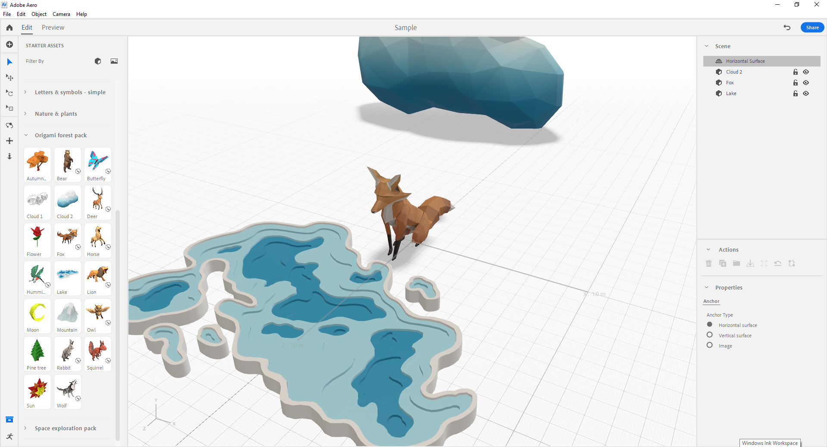
And?

Slide 52
Others
The prior slides show some of the known challenges with deploying AR for learning.
“Shift(ing) left” or addressing accessibility early in AR design and development is advisable to head off problems requiring excessive retrofitting.
It is important to test and re-test against potential harms prior to going live.
What are test users experiencing with going through an AR experience?
Are test users those who have varying abilities and experiences? Do they provide a diversity of insights?

Slide 54
References

Slide 55
References
Azuma, R. T. (1997). A survey of augmented reality. Presence: Teleoperators & Virtual Environments, 6(4), 355-385.
Doerner, R., Broll, W., Jung, B., Grimm, P., Göbel, M., & Kruse, R. (2022). Introduction to virtual and augmented reality. In Virtual and Augmented Reality (VR/AR) (pp. 1-37). Springer, Cham.

Slide 56
References (cont.)
Oswald, P., Tost, J., & Wettach, R. (2014, November). The real augmented reality: real-time game editor in a spatial augmented environment. In Proceedings of the 11th Conference on Advances in Computer Entertainment Technology (pp. 1-4).
Smith, Heather Dunaway. (2022, June 20). Adobe.com. Retrieved from https://helpx.adobe.com/aero/how-to/augmented-reality-workflows-best-practices-aero.html

Slide 58
Contact and Communications
Dr. Shalin Hai-Jew
Instructional Analysis, Design, and Development
Kansas State University
785-532-5262
shalin@ksu.edu

Slide 59
Questions?
If you have questions, please email me at [shalin@ksu.edu].
Thanks to the organizers of the Accessibility Summer Camp 2023 for including me.
This is a pre-recorded session.
Thank you for participating!

